Slide 1


Slide 2
Control Structure nesting

Slide 3
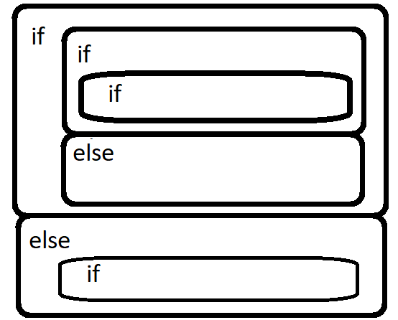
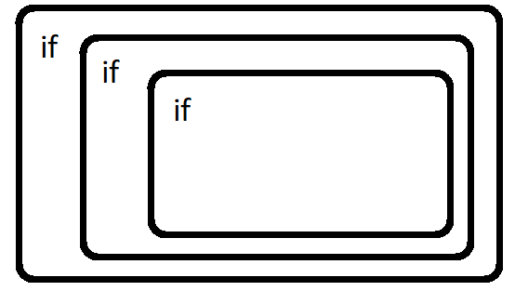
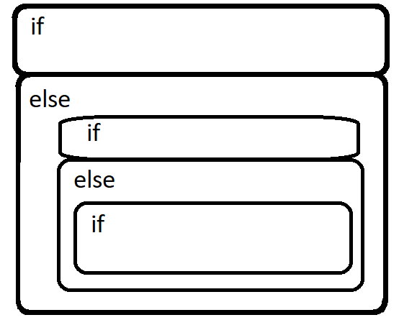

Slide 4
if (week day)
if(less distance)
go by foot
else
if(not raining)
ride motorbike
else
drive car
else
take rest
if (have to go to market)
if(raining)
bring umbrella
if (it is hot)
if(you like coffee)
drink coffee
else
drink tea

Slide 5

Create control nesting of 2 real life scenarios

Slide 6
Repetition Structure nesting

Slide 7
Repeat every week
Repeat for Mon, Tue, Wed, Thu, Fri, Sat, Sun
-> Wake up
Brush your teeth
Rub teeth repeatedly
-> Sleep

Slide 8
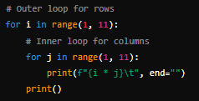
This code generates a multiplication table from 1 to 10. It uses two nested loops:
Outer Loop: Iterates over the numbers 1 through 10 to represent the rows.
Inner Loop: Iterates over the numbers 1 through 10 to represent the columns.
For each pair of numbers (i and j), their product (i * j) is printed, followed by a tab space (\t). The end="" parameter ensures that the products are printed on the same line.
After completing each row, a newline character is printed to move to the next line. This creates a well-formatted multiplication table.

Slide 9
Create repetition nesting of 2 real life scenarios

Slide 10
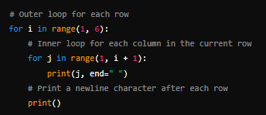
Guess Output

Slide 11
Write python code for the following :
(a) * * * * *
* * * * *
* * * * * * * * * * * * * * *
(b) *
* *
* * * * * * * * * * * *
(c) * * * * *
* * * *
* * * * *

Slide 12
HOME
Write python codes for the following :
(a) *
* * *
* * * * * * * * * * * * * * * * * * * * *
(b) 1
1 3
1 3 5 1 3 5 7 1 3 5 7 9
(c) 5 5 5 5 5
4 4 4 4
3 3 3
2 2 1

